Slide 1


Slide 2
souvenir photo

Slide 4
cs50.ly/favorites
Notes:
https://forms.gle/WwxB5tNJQ6uvPjHAA

Slide 5


Notes:
https://emojipedia.org/apple/ios-17.4/selfie

Slide 6
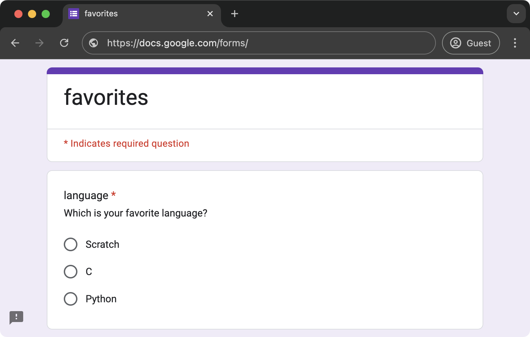
Notes:
https://docs.google.com/forms/d/e/1FAIpQLScxhPm4DSar6J8Yh1yMBEPQ0ihA6s3RuCUdVygr-3wB6jR4Rg/viewform

Slide 7
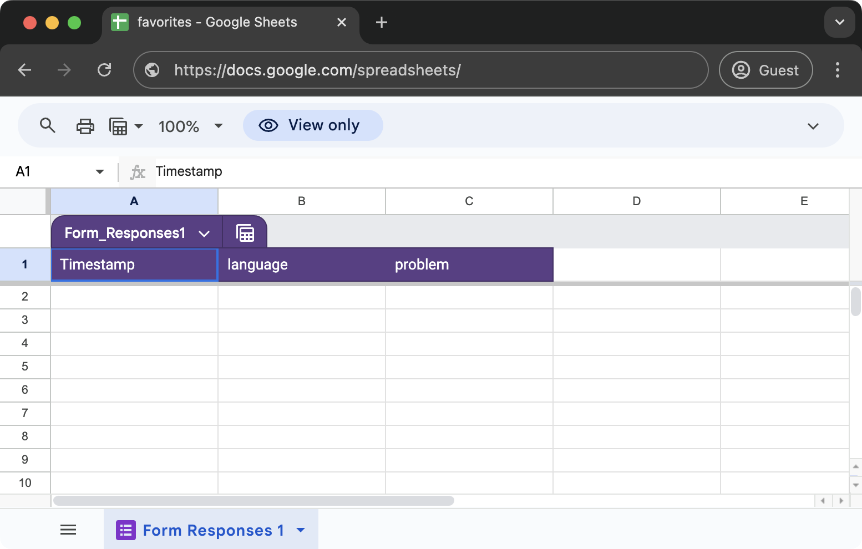
Notes:
https://docs.google.com/spreadsheets/d/1Todn2bYuRz_LqYrOaJy-A9XVoynhncqICRTnHluc38o/edit?usp=sharing

Slide 8
flat-file database

Slide 9
CSV
Notes:
favorites{0,1,2,3,4}.py

Slide 10
key | value
Notes:
favorites{5,6,7,8}.py

Slide 11
relational database

Slide 12
SQL

Slide 13
C
R
U
D

Slide 14
CREATE
READ
UPDATE
DELETE

Slide 15
CREATE
SELECT
UPDATE
DELETE

Slide 16
CREATE, INSERT
SELECT
UPDATE
DELETE

Slide 17
CREATE, INSERT
SELECT
UPDATE
DELETE, DROP

Slide 18
CREATE, INSERT
SELECT
UPDATE
DELETE, DROP
...

Slide 19
CREATE TABLE table (column type, ...);

Slide 20
sqlite3

Slide 21
sqlite3 FILE

Slide 22
.mode csv
.import FILE TABLE
.quit
Notes:
favorites.csv

Slide 23
.schema

Slide 24
SELECT columns FROM table;
...
Notes:
SELECT * FROM favorites;
SELECT language FROM favorites;

Slide 25
AVG
COUNT
DISTINCT
LOWER
MAX
MIN
UPPER
...
Notes:
SELECT COUNT(*) FROM favorites;
SELECT DISTINCT language FROM favorites;
SELECT COUNT(DISTINCT language) FROM favorites;

Slide 26
GROUP BY
LIKE
LIMIT
ORDER BY
WHERE
...
Notes:
SELECT COUNT(*) FROM favorites WHERE language = 'C';
SELECT COUNT(*) FROM favorites WHERE language = 'C' AND problem = 'Hello, World';
SELECT COUNT(*) FROM favorites WHERE language = 'C' AND (problem = 'Hello, World' OR problem = 'Hello, It''s Me');
SELECT COUNT(*) FROM favorites WHERE language = 'C' AND problem LIKE 'Hello, %';

Slide 27
language
C
Python
Python
SQL
Python
SQL
Notes:
SELECT language, COUNT(*) FROM favorites GROUP BY language;

Slide 28
language
C
Python
Python
SQL
Python
SQL

Slide 29
language
C
Python
Python
SQL
Python
SQL

Slide 30
language
C
Python
Python
SQL
Python
SQL

Slide 31
language | COUNT(*)
C | 1
Python | 3
SQL | 2

Slide 32
GROUP BY
LIKE
LIMIT
ORDER BY
WHERE
...
Notes:
SELECT language, COUNT(*) FROM favorites GROUP BY language ORDER BY COUNT(*) DESC;
SELECT language, COUNT(*) AS n FROM favorites GROUP BY language ORDER BY n DESC;
SELECT language, COUNT(*) AS n FROM favorites GROUP BY language ORDER BY n DESC LIMIT 1;

Slide 33
INSERT INTO table (column, ...) VALUES(value, ...);
Notes:
INSERT INTO favorites (language, problem) VALUES('SQL', 'Fiftyville');
SELECT * FROM favorites;

Slide 34
NULL

Slide 35
DELETE FROM table WHERE condition;
Notes:
DELETE FROM favorites WHERE Timestamp IS NULL;

Slide 36
UPDATE table SET column = value WHERE condition;
Notes:
UPDATE favorites SET language = 'SQL', problem = 'Fiftyville';
SELECT * FROM favorites;
DELETE FROM favorites;
SELECT * FROM favorites;

Slide 37
IMDb
Notes:
https://docs.google.com/spreadsheets/d/15g5bRE3WF2PgkCm9LhKn2hdOmTxhk9aX_U06TMYcu0A/edit?usp=sharing
https://docs.google.com/spreadsheets/d/1tETwE0k0tERu1p1aOt8Rfitot1k3f77ywS8kicBPqdg/edit?usp=sharing
https://docs.google.com/spreadsheets/d/1Ey_E4W1LsHYp2MPWMqv8Q8IFNDcoAth_hUQNx3j3uV8/edit?usp=sharing

Slide 38
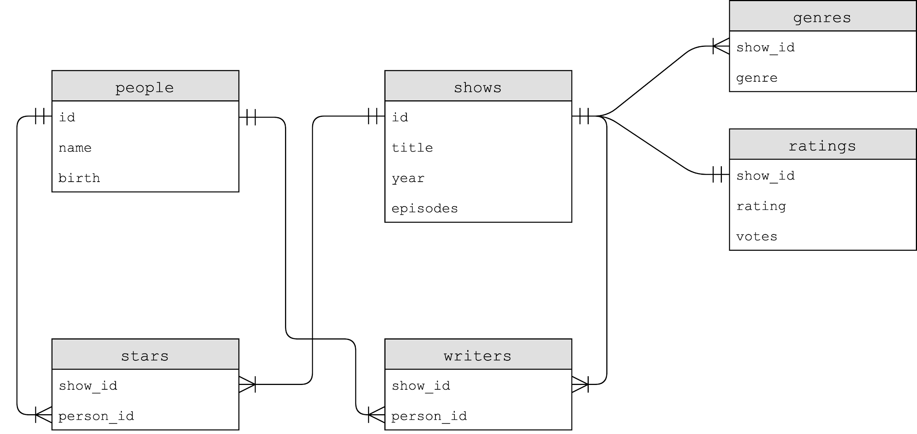

Slide 39
Notes:
SELECT * FROM shows LIMIT 10;
SELECT * FROM ratings LIMIT 10;

Slide 40
one-to-one

Slide 41
Notes:
.schema shows
.schema ratings

Slide 42
BLOB
INTEGER
NUMERIC
REAL
TEXT

Slide 43
NOT NULL
UNIQUE

Slide 44
PRIMARY KEY
FOREIGN KEY
Notes:
SELECT * FROM ratings WHERE rating >= 6.0 LIMIT 10;
SELECT show_id FROM ratings WHERE rating >= 6.0 LIMIT 10;
SELECT * FROM shows WHERE id IN (SELECT show_id FROM ratings WHERE rating >= 6.0) LIMIT 10;
SELECT title FROM shows WHERE id IN (SELECT show_id FROM ratings WHERE rating >= 6.0) LIMIT 10;

Slide 45
JOIN

Slide 46
id | title
386676 | The Office
show_id | rating
386676 | …

Slide 47
title | id
The Office | 386676
show_id | rating
386676 | …

Slide 48
title | id
The Office | 386676
show_id | rating
386676 | …
Notes:
SELECT * FROM shows JOIN ratings ON shows.id = ratings.show_id WHERE rating >= 6.0 LIMIT 10;

Slide 49
title | id
The Office | 386676
show_id | rating
386676 | …

Slide 50
title | id
The Office | 386676
rating
…

Slide 51
title
The Office
rating
…
Notes:
SELECT title, rating FROM shows JOIN ratings ON shows.id = ratings.show_id WHERE rating >= 6.0 LIMIT 10;

Slide 53
Notes:
SELECT * FROM genres LIMIT 10;
SELECT * FROM shows WHERE id = 63881;

Slide 54
one-to-many
Notes:
.schema genres
SELECT genre FROM genres WHERE show_id = 63881;
SELECT genre FROM genres WHERE show_id = (SELECT id FROM shows WHERE title = 'Catweazle');

Slide 55
id | title
63881 | Catweazle
show_id | genre
63881 | Adventure
63881 | Comedy
63881 | Family

Slide 56
title | id
Catweazle | 63881
show_id | genre
63881 | Adventure
63881 | Comedy
63881 | Family

Slide 57
title | id
Catweazle | 63881
show_id | genre
63881 | Adventure
63881 | Comedy
63881 | Family
Notes:
SELECT * FROM shows JOIN genres ON shows.id = genres.show_id WHERE id = 63881;

Slide 58
title | id
Catweazle | 63881
show_id | genre
63881 | Adventure
63881 | Comedy
63881 | Family

Slide 59
title | id
Catweazle | 63881
Catweazle | 63881
Catweazle | 63881
show_id | genre
63881 | Adventure
63881 | Comedy
63881 | Family

Slide 60
title | id
Catweazle | 63881
Catweazle | 63881
Catweazle | 63881
genre
Adventure
Comedy
Family

Slide 61
title
Catweazle
Catweazle
Catweazle
genre
Adventure
Comedy
Family
Notes:
SELECT title, genre FROM shows JOIN genres ON shows.id = genres.show_id WHERE id = 63881;

Slide 62
genre
Adventure
Comedy
Family
Notes:
SELECT genre FROM shows JOIN genres ON shows.id = genres.show_id WHERE id = 63881;

Slide 65
many-to-many
Notes:
SELECT * FROM shows WHERE title = 'The Office';
SELECT * FROM shows WHERE title = 'The Office' AND year = 2005;
SELECT name FROM people WHERE id IN
(SELECT person_id FROM stars WHERE show_id =
(SELECT id FROM shows WHERE title = 'The Office' AND year = 2005));
SELECT title FROM shows WHERE id IN
(SELECT show_id FROM stars WHERE person_id =
(SELECT id FROM people WHERE name = 'Steve Carell'));
SELECT title FROM shows
JOIN stars ON shows.id = stars.show_id
JOIN people ON stars.person_id = people.id
WHERE name = 'Steve Carell';
SELECT title FROM shows, stars, people WHERE shows.id = stars.show_id
AND people.id = stars.person_id
AND name = 'Steve Carell';

Slide 66
Notes:
.schema writers

Slide 67
indexes
Notes:
.timer ON
SELECT * FROM shows WHERE title = 'The Office';

Slide 68
CREATE INDEX name ON table (column, ...);
Notes:
CREATE INDEX title_index ON shows (title);
SELECT * FROM shows WHERE title = 'The Office';

Slide 69
B-trees

Slide 70
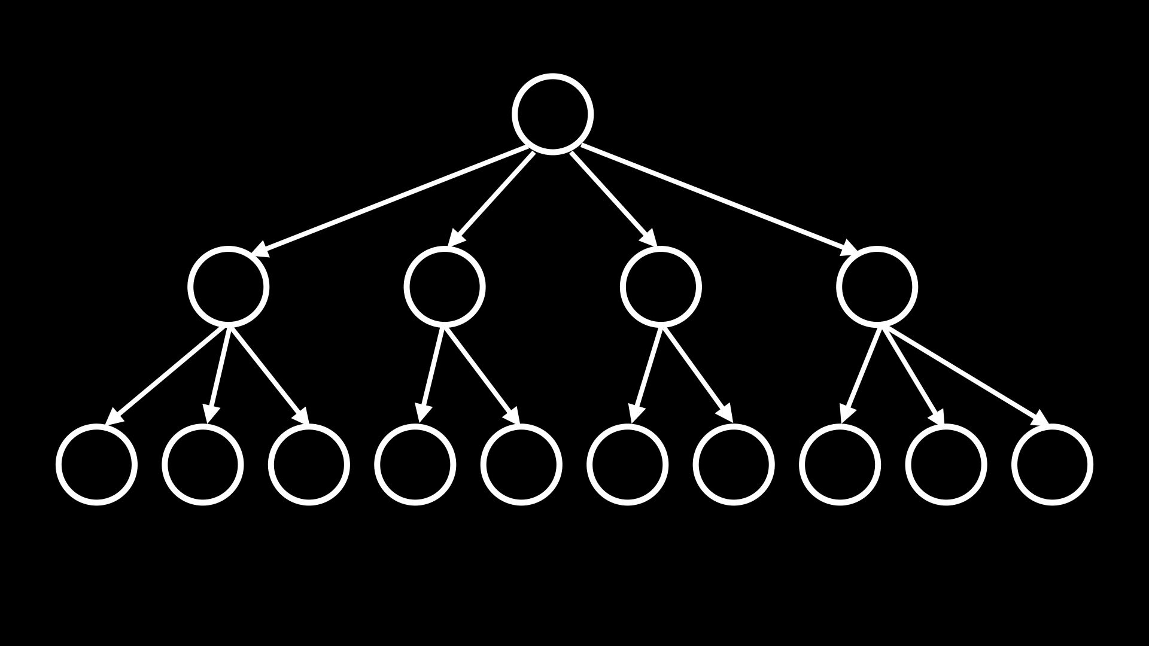
Notes:
SELECT title FROM shows, stars, people
WHERE shows.id = stars.show_id
AND people.id = stars.person_id
AND name = 'Steve Carell';
SELECT title FROM shows WHERE id IN
(SELECT show_id FROM stars WHERE person_id =
(SELECT id FROM people WHERE name = 'Steve Carell'));
CREATE INDEX name_index ON people (name);
CREATE INDEX person_index ON stars (person_id);
SELECT title FROM shows WHERE id IN
(SELECT show_id FROM stars WHERE person_id =
(SELECT id FROM people WHERE name = 'Steve Carell'));

Slide 71
from cs50 import SQL

Slide 72
cs50.readthedocs.io/libraries/cs50/python/#cs50.SQL
Notes:
favorites8.py

Slide 73
race conditions
Notes:
MILK STORY (lock or note)

Slide 74

Notes:
https://www.instagram.com/p/CmUv48DLvxd/

Slide 75
rows = db.execute("SELECT likes FROM posts WHERE id = ?", id);
likes = rows[0]["likes"]
db.execute("UPDATE posts SET likes = ? WHERE id = ?", likes + 1, id);

Slide 76
BEGIN TRANSACTION
COMMIT
ROLLBACK

Slide 77
db.execute("BEGIN TRANSACTION")
rows = db.execute("SELECT likes FROM posts WHERE id = ?", id);
likes = rows[0]["likes"]
db.execute("UPDATE posts SET likes = ? WHERE id = ?", likes + 1, id);
db.execute("COMMIT")

Slide 78
SQL injection attacks

Slide 79
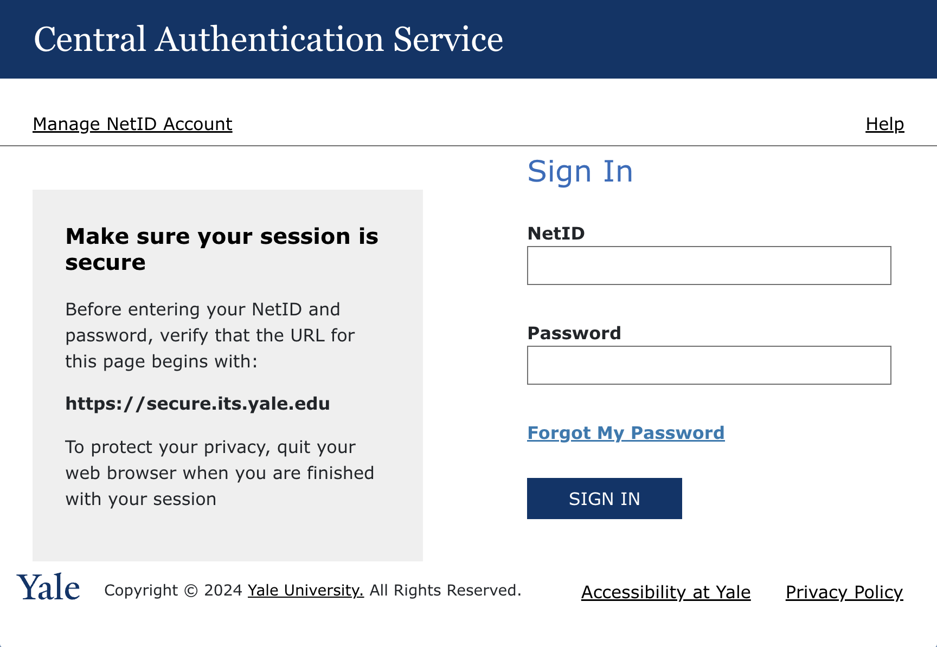

Slide 80
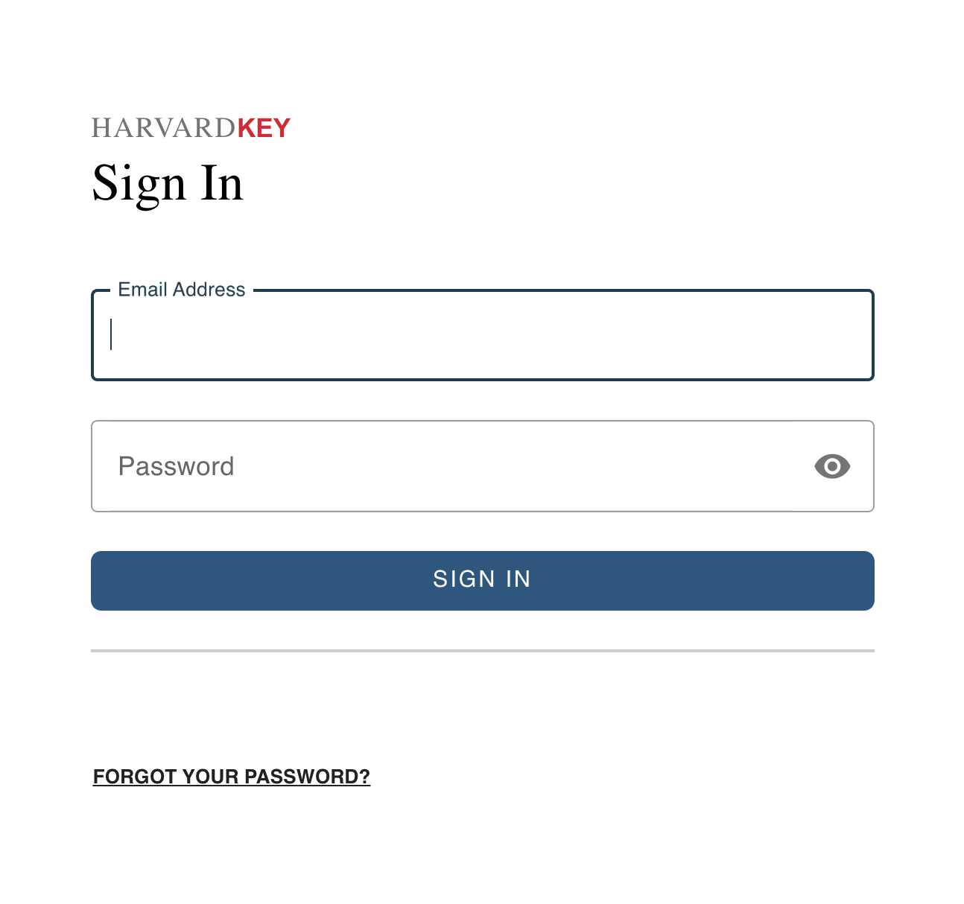

Slide 81
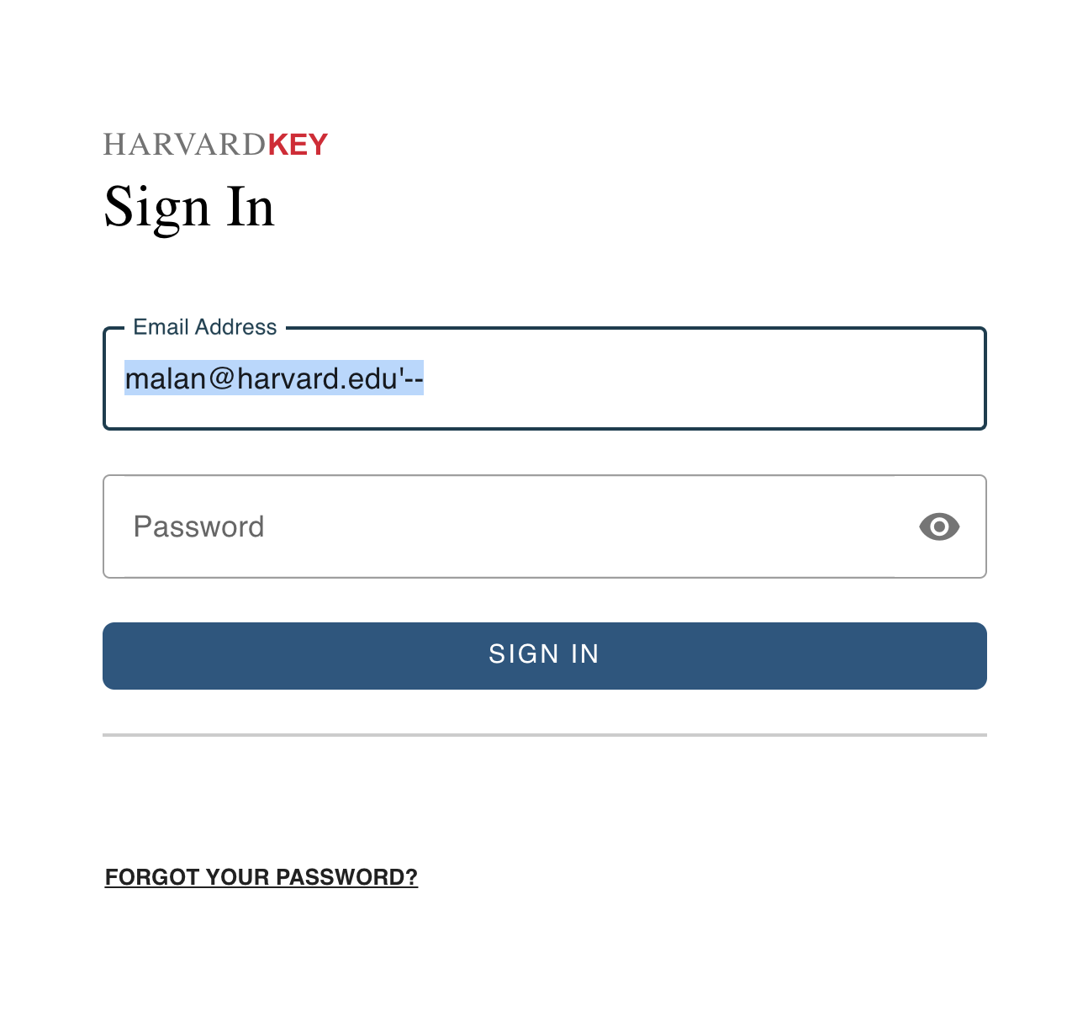

Slide 82
rows = db.execute("SELECT * FROM users WHERE username = ? AND password = ?", username, password)
if rows:
...

Slide 83
rows = db.execute("SELECT * FROM users WHERE username = ? AND password = ?", username, password)
if rows:
...

Slide 84
rows = db.execute("SELECT * FROM users WHERE username = ? AND password = ?", username, password)
if rows:
...

Slide 85
rows = db.execute(f"SELECT * FROM users WHERE username = '{username}' AND password = '{password}'")
if rows:
...

Slide 86
rows = db.execute(f"SELECT * FROM users WHERE username = 'malan@harvard.edu'--' AND password = '{password}'")
if rows:
...

Slide 87
rows = db.execute(f"SELECT * FROM users WHERE username = 'malan@harvard.edu'--' AND password = '{password}'")
if rows:
...

Slide 88
rows = db.execute(f"SELECT * FROM users WHERE username = 'malan@harvard.edu'--' AND password = '{password}'")
if rows:
...

Slide 89
rows = db.execute(f"SELECT * FROM users WHERE username = 'malan@harvard.edu''--' AND password = '{password}'")
if rows:
...

Slide 90
rows = db.execute("SELECT * FROM users WHERE username = ? AND password = ?", username, password)
if rows:
...

Slide 91
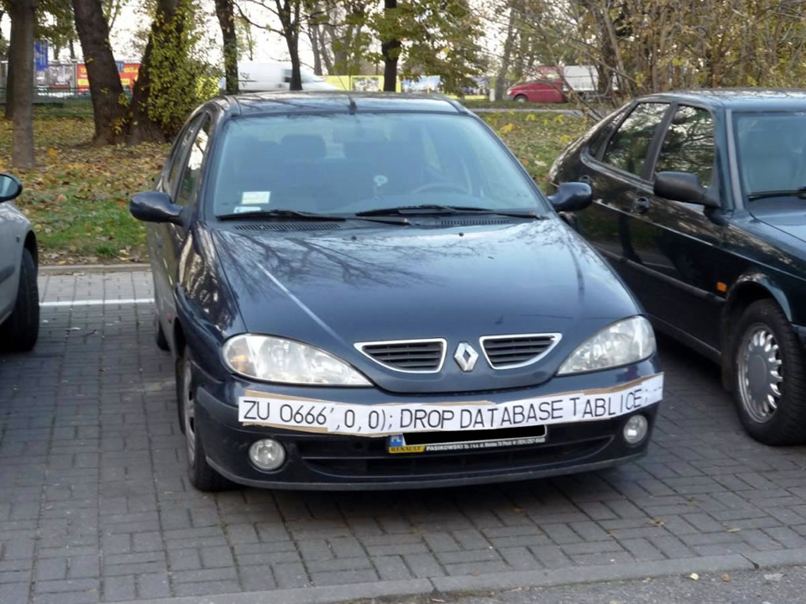

Slide 92
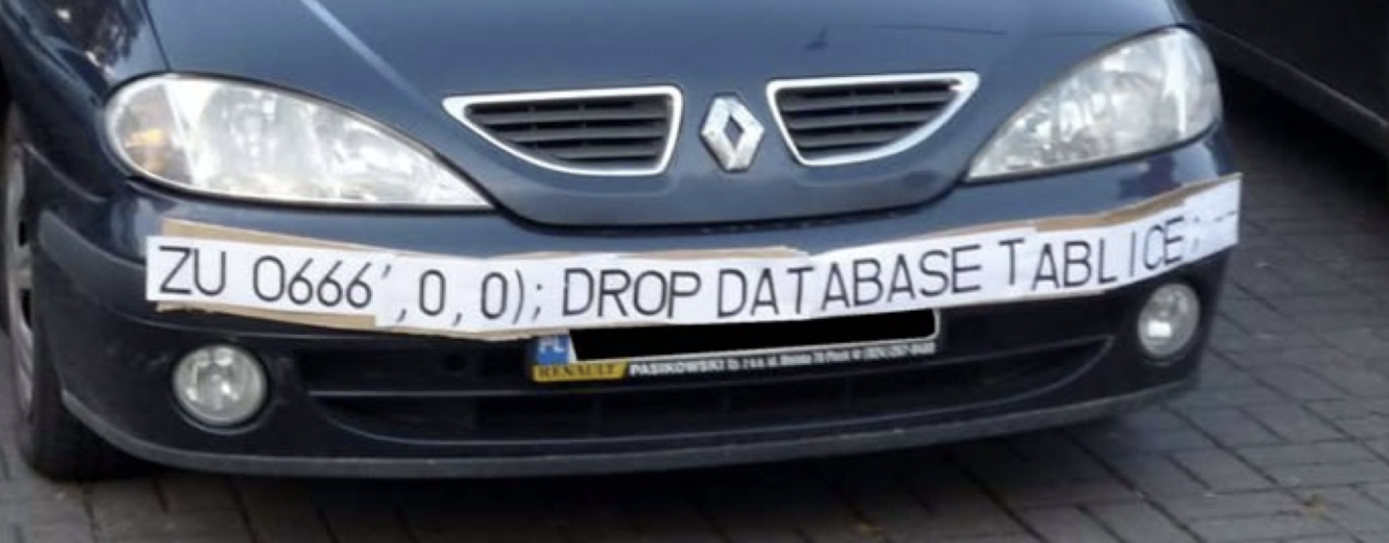

Slide 93
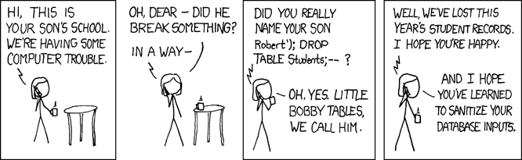
Notes:
https://xkcd.com/327/

